Slide 1
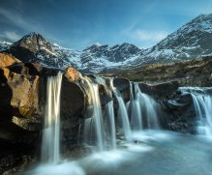
Brief History of Northern Scotland
History of Isle of Skye and the impact of Norse Culture

Slide 2
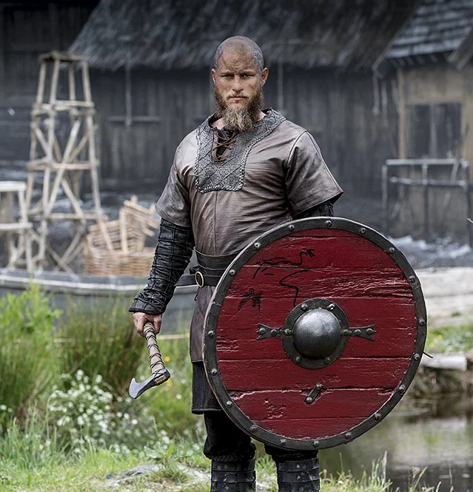
Hollywood Image of Vikings and the true images of the Norse people
Viking was a term meaning (to raid), which all accounts were recorded from the people who were negatively impacted by the effects of the raids.
True facts – the majority of the Norse people thrived in farming, merchant trading and metallargy and art.
Horns on Helmets (true or false)
Tattoos (true or false)
Status of Female Warriors (true or false)

Slide 3
What did other cultures write about Norse Vikings and Celtic Tribes?
https://penelope.uchicago.edu/~grout/encyclopaedia_romana/britannia/miscellanea/geography.html
The perseption of the Irish and Scotish physcial features. The origin of red hair, and green eyes (myth or reality?).
Quotes from Caesar - Even more indicative of their otherness is that the Britons "dye their bodies with woad, which produces a blue colour" (Caesar, Gallic War, V.14; also Pomponius Mela, III.6.51). Together with the use of chariots, it is a characterizing topos of the natives. Pliny remarks that the wives and daughters-in-law of the Britons "stain all the body" with woad (Natural History, XXII. 2) and Propertius warns his mistress, in painting her own face blue, not to imitate the British (Elegies, II.18c.23). For Ovid, they are "the green painted Britons"

Slide 4
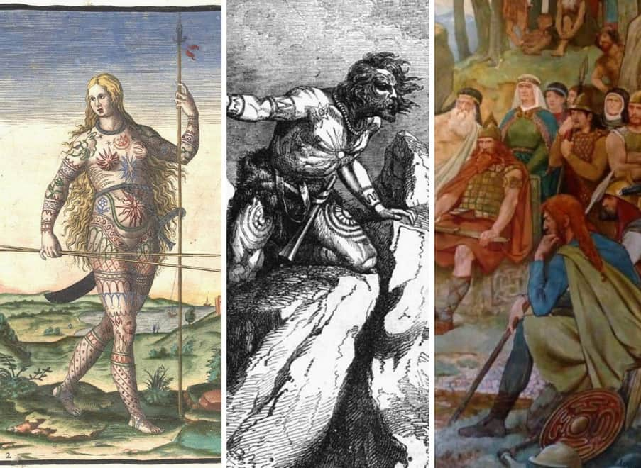
Views of the Picts from the Romans

Slide 5
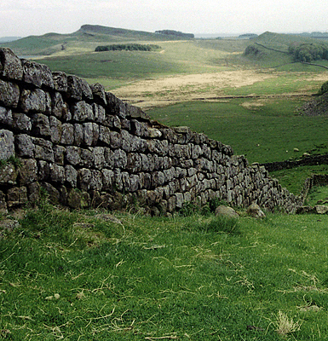
Hadrian's Wall – Keeping the Celtic and Norse out of Britania
Herodian writes, as well, of Severus in Britain.
"Most of Britain is marshland because it is flooded by the continual ocean tides. The barbarians usually swim in these swamps or run along in them, submerged up to the waist. Of course, they are practically naked and do not mind the mud because they are unfamiliar with the use of clothing, and they adorn their waists and necks with iron, valuing this metal as an ornament and a token of wealth in the way that other barbarians value gold. They also tattoo their bodies with various patterns and pictures of all sorts of animals. Hence the reason why they do not wear clothes, so as not to cover the pictures on their bodies. They are very fierce and dangerous fighters, protected only by a narrow shield and a spear, with a sword slung from their naked bodies. They are not familiar with the use of breast-plates and helmets, considering them to be an impediment to crossing the marshes. Because of the thick mist which rises from the marshes, the atmosphere in this region is always gloomy" (III.14.6-8).

Slide 6
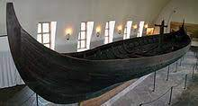
Viking Migration, navigation and ship construction

Slide 7
Gokstad Viking Ship https://www.youtube.com/watch?v=yB4s3nQtZqE

Slide 8
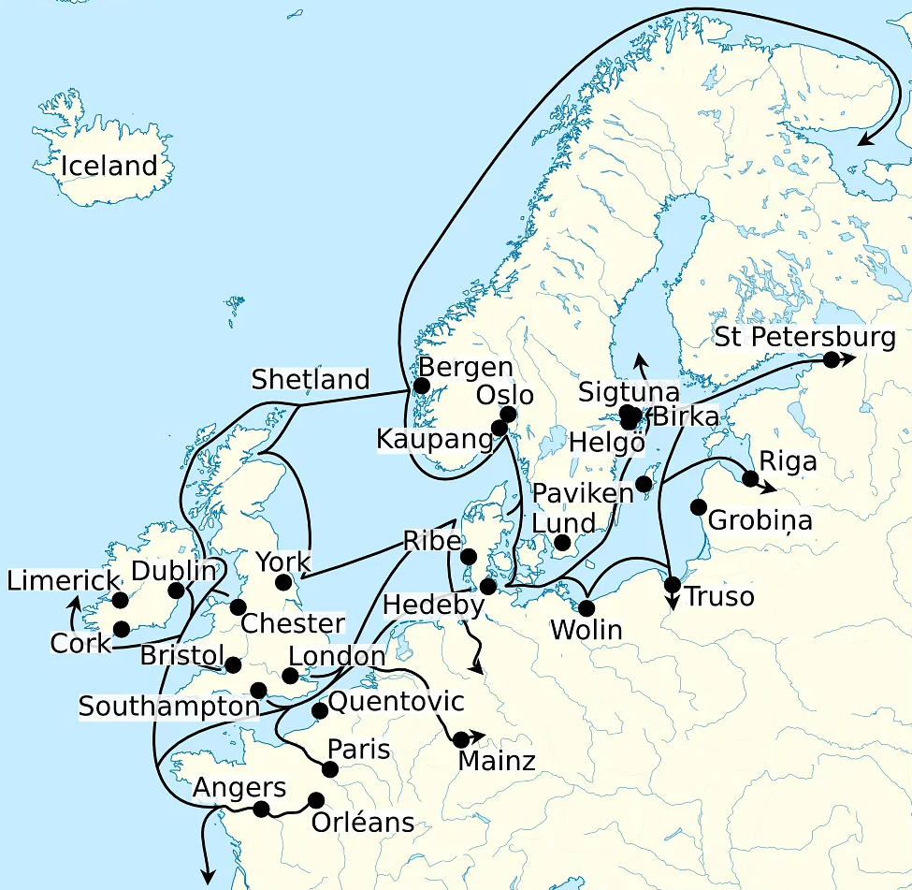
First arrival of the Viking raids of 793 AD.

Slide 9
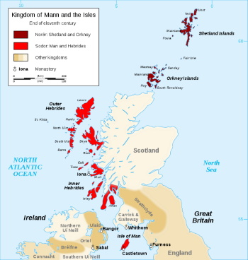
Norse influences in Celtic Culture and Art
As the Norse (i.e., Today called - Sweden, Norway, Finland and Denmark), the Norse "Viking" raids were often but many of the Norse People who settled in Northern Scotland, Ireland and Wales assimilated into Celtic Culture so did Celtic tribes borrowed from Norse cultures.
Languages - each cultural tribe of Celtic and Norse settlers exchanged language, where words and phrase changed. https://www.youtube.com/watch?v=rPokZgAdXSo
The mythology and folklore of oral history stories were exchanged.
Technology of metal work, shipbuilding and social standards.
The major impact that changed all cultures is Roman occupation and Christianity.

Slide 10
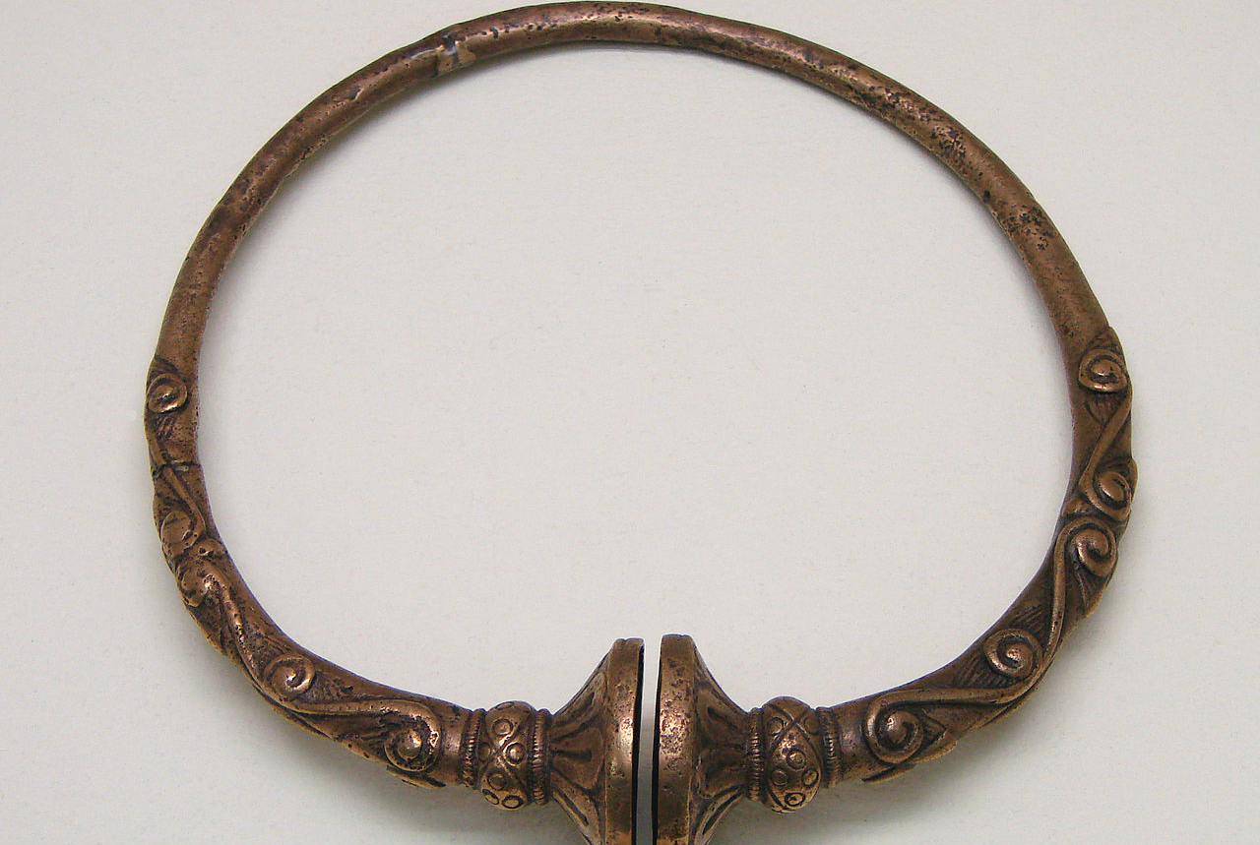
Torcs – Social Status – both designs implicated in Norse and Celtic tribes

Slide 11
Pict History (site - https://www.britannica.com/topic/Pict)
Pict, (possibly from Latin picti, “painted”), one of an ancient people who lived in what is now eastern and northeastern Scotland, from Caithness to Fife. Their name may refer to their custom of body painting or possibly tattooing.
The origin of the Picts is uncertain; some evidence suggests that they were descendants of pre-Celtic aborigines, but some linguistic evidence suggests they spoke a Celtic language. The Picts were first noticed in AD 297, when a Roman writer spoke of the “Picts and Irish [Scots] attacking” Hadrian’s Wall. Their warfare with the Romans during the occupation was almost continual. By the 7th century there was a united “Pict-land,” which already had been penetrated by Christianity. In 843, Kenneth I MacAlpin, king of the Scots (centred in Argyll and Bute), became also king of the Picts, uniting their two lands in a new kingdom of Alba, which evolved into Scotland.
The Pictish kingdom is notable for the stylized but vigorous beauty of its carved memorial stones and crosses. The round stone towers known as brochs, or “Pictish towers,” and the underground stone houses called weems, or “Picts’ houses,” however, both predate this kingdom.

Slide 12
Ancient Celtic art of Isle of Skye and Northern Scotland

Slide 13
Celtic Tribes of ancient Britania, Scotland and Ireland

Slide 14
Circle Stones of Early forms of Stonehenge on Skye Isle

Slide 15
The Callanish Circle Stones of Isle and Skye "Stonehenge of the North"

Slide 16
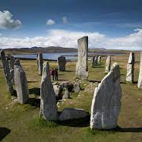
3D View
https://www.youtube.com/watch?v=mkbEhp8hJN8

Slide 17
Crannog – Round House https://crannog.co.uk/museum-development/

Slide 18
The Lost Written Language and Symbols of Pictish Culture of the Isle of Skye (Class I)
https://ima.princeton.edu/2017/07/31/pictish-stones-iconography-and-interpretation/

Slide 19
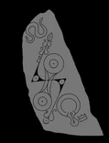
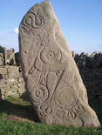
Early Pict Writing on (Class II), The Aberlemno Serpent stone
Site - Reference
https://ima.princeton.edu/2017/07/31/pictish-stones-iconography-and-interpretation/

Slide 20
Pict - Class II stone, located at Brodie, Northern Scotland

Slide 21
Change of Pict and Norse Art with early Christian influences

Slide 22
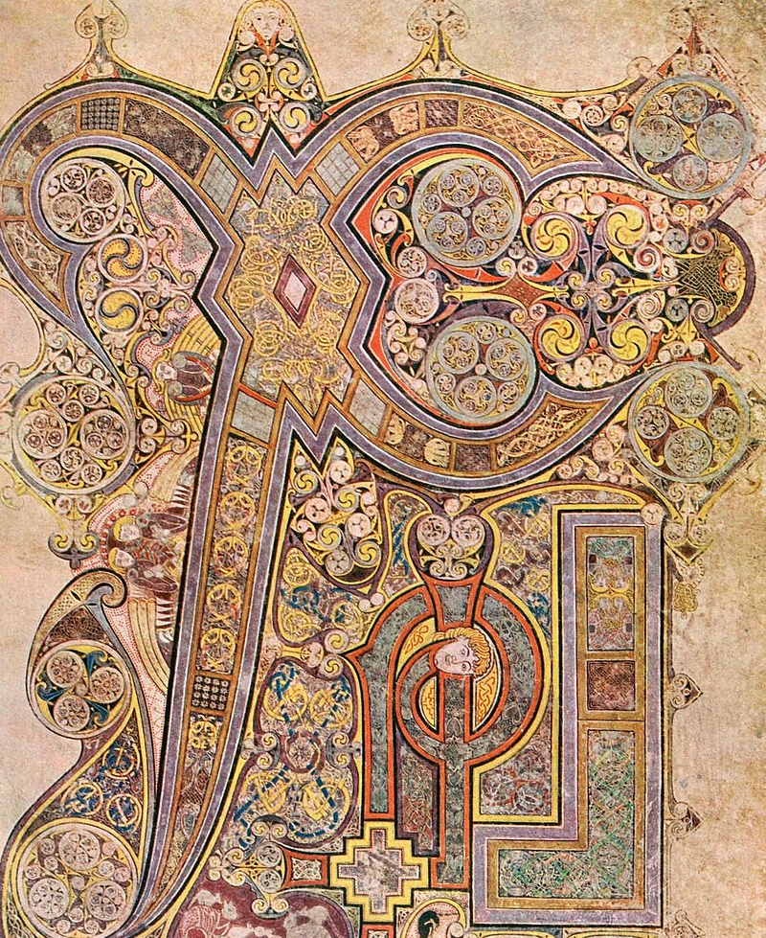
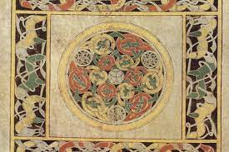
The impact of Christianity with Celtic/Norse influences
Book of Kells

Slide 23
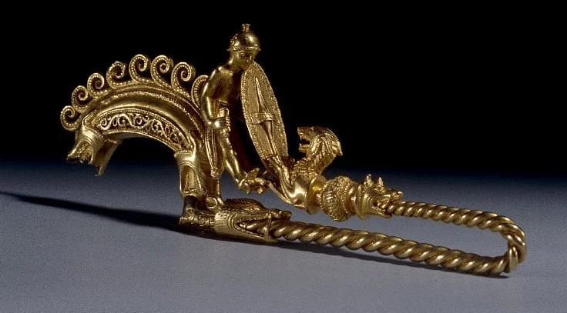
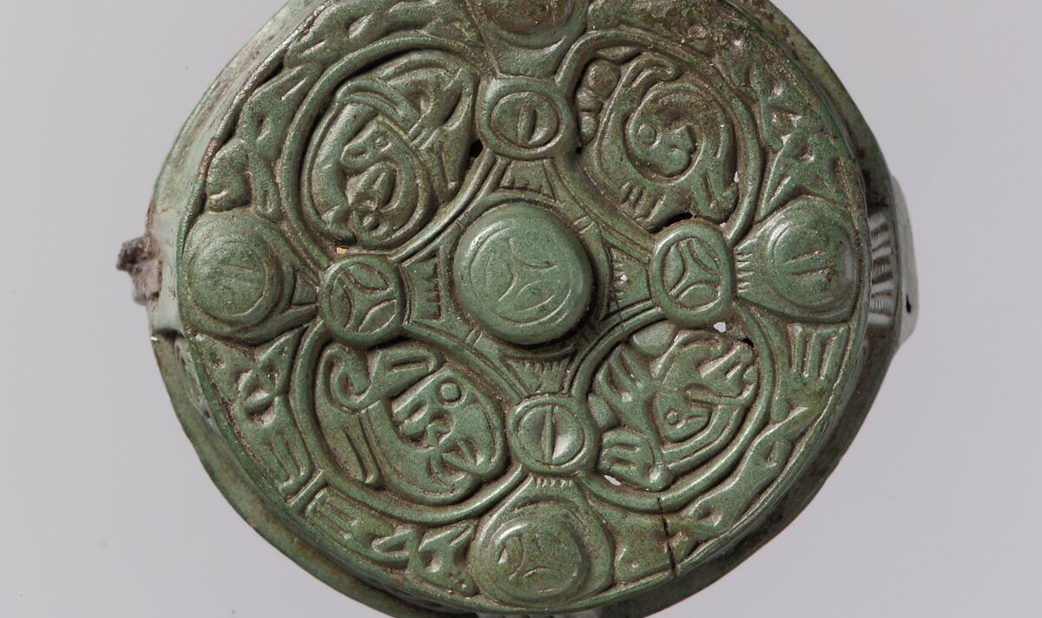
Celtic and Norse influences in metal artwork

Slide 24
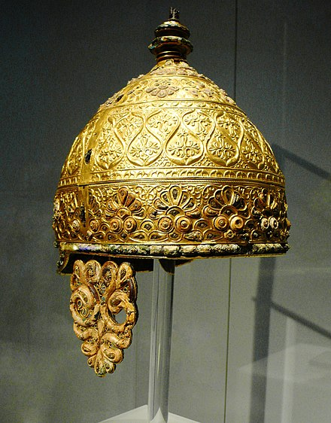
La Tene Period

Slide 25
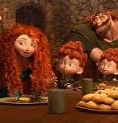
Past and Today's influences of Ancient Norse and Celtic Culture
English Authors, early Christian historical writings (King Arther) early elements of country music in Bluegrass, Folklore (i.e., fairies, elves, mythical animals and symbols of animals) and the English root languages.
Today – Tattoos, Movies and Music.
Examples of famous movies - Lord of the Rings series, Conan the Barbarian, Brave (Disney), many films of King Arthur.

Slide 26
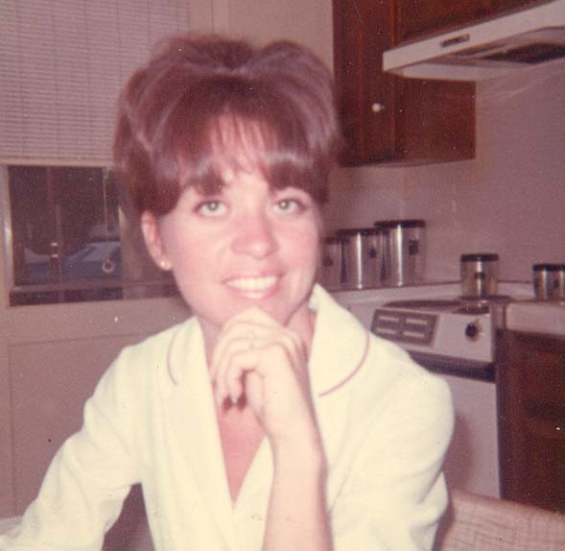
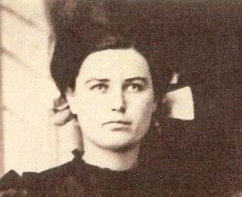
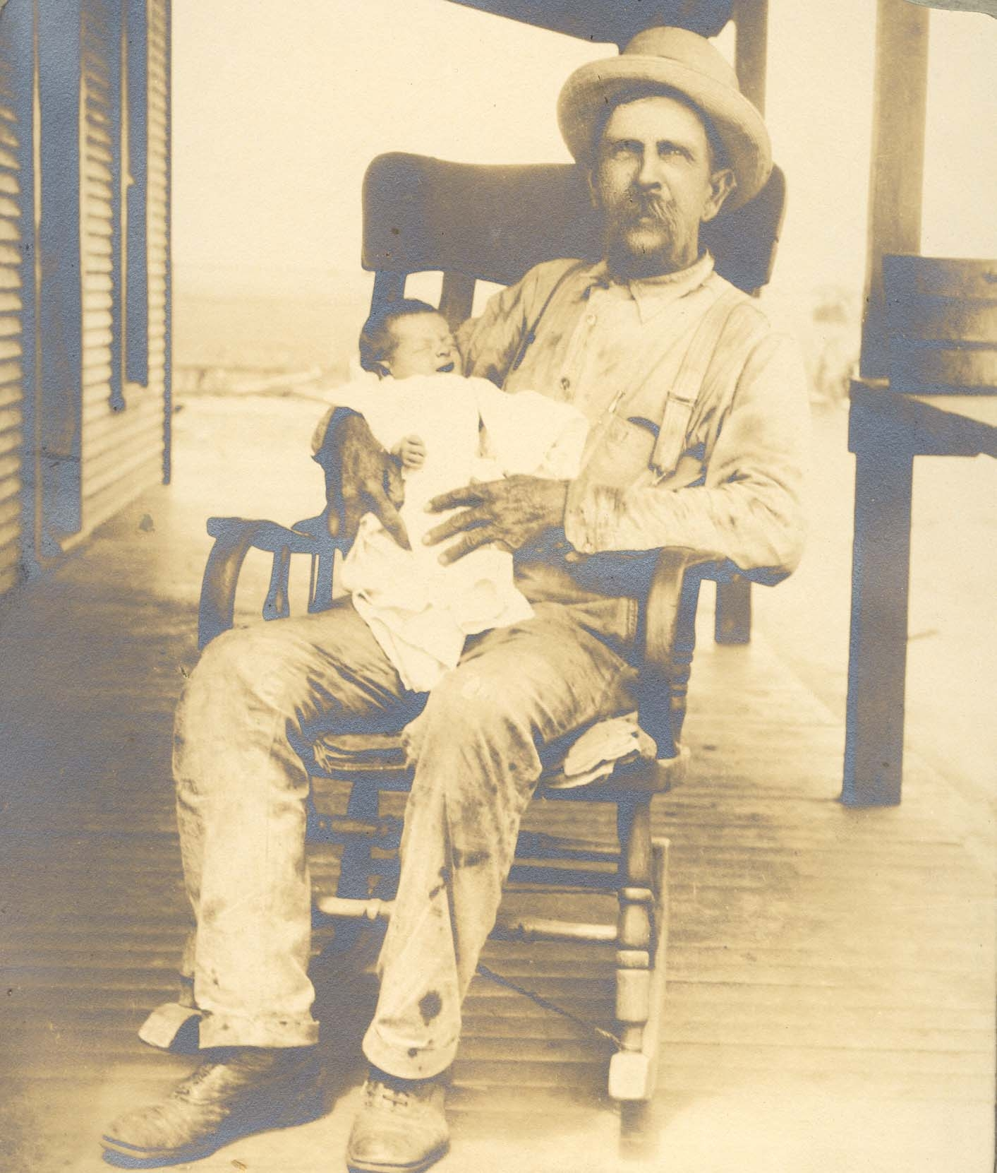
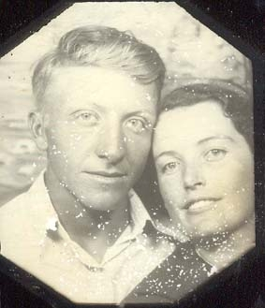
Questions and Answer Portion
Ask Away!! :)

